Slide 1

Project Name: P251- BANK loan of customers
Mentor : Mr. Shubham
Group No : 3

Slide 2

Group Members
Mr. Jayrajsinh Dodiya
Mr. Omkar Haridas Auti
Ms. Shefali Premkumar Meshram
Ms.Pooja Sukhram Hume
Mr. Himanshu Kulkarni
Ms. Jyoti Jain
Mr Arun Kumar Yadav
Mr. Aman Gupta
Mr. Partha Sarathi Mohanty
Ms. Rashmi Kale

Slide 3

Datasets
This is Bank Loan of Customers Project Where Provided 2 dataset to us With csv extension files having 39k rows each and the objective was to analyze the growth that bank got within given years in loans.
We used MS-Excel ,MySQL for analyzing ,cleaning and removing duplicates from dataset and prepared KPI’s .Where we did calculations ,merging and Prepared interactive Dashboards

Slide 4

KPI’S
Year wise loan amount stats
Grade and sub grade wise revol_bal
Total payment for verified status Vs total payment for non verified status
State wise and last_credit_pull_d wise loan status
Home ownership Vs last payment date stats

Slide 5

We performed this project in below 4 modules:
Excel
SQL
Tableau
Power BI

Slide 6
1. Year Wise Loan Amount Stats:
1. By this analysis we can see loan amount is increasing every year.
2. Loan amount was 2,219,275M in year 2007 and 260,506,575M in 2011 which is the highest in last 5 years.
3. Difference of loan amount from 2007 to 2011 is 260,506,575-2,219,275=258,287,300M
4. Loan amount is increased by 258,287,300M in last 4 years.
Year | Loan Amount
2007 | 2219275.00
2008 | 14390275.00
2009 | 46436325.00
2010 | 122050200.00
2011 | 260506575.00
Grand Total | 445602650.00

Slide 7

2. Grade And Sub Grade Wise Revol_bal:
In this Grade and Sub-Grade wise revol balance, we can notice Grade-B have more revol balance then any other grade & Grade-G have very low revol balance.
More numbers of customers took loan in Grade-B.
Similarly, it goes for other grades also, B>A>C>D>E>F>G is the order for revol balance as per annual income.

Slide 8
3. Total Payment For Verified Status Vs Non Verified Status :
Looking at this chart we can observe that verified status is 321,962,975M which is 68% of the total loan amount and for non-verified status 153,541,418 which is 32% of the total loan amount.
The bank needs a loan application to initiate the documents collection and verification process.

Slide 9
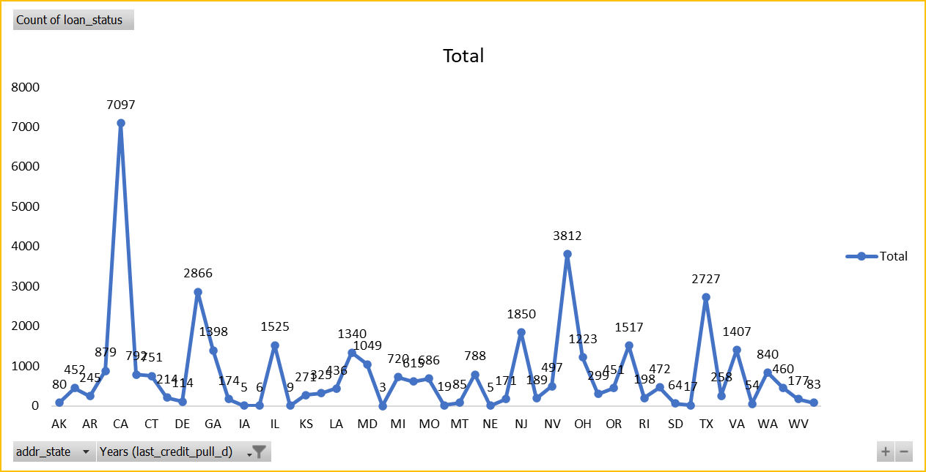
4. State Wise And Last_credit_pull_d Wise Loan status :
The graph shows the count of Loan Status in each states of USA on particular last credit pull date.
It is clearly seen that in top 10 states CA has given maximum amount of loan customers and lowest is WV.
As we can see CA has given maximum customers who took loan i.e., > 6000 is the count of loan status.

Slide 10
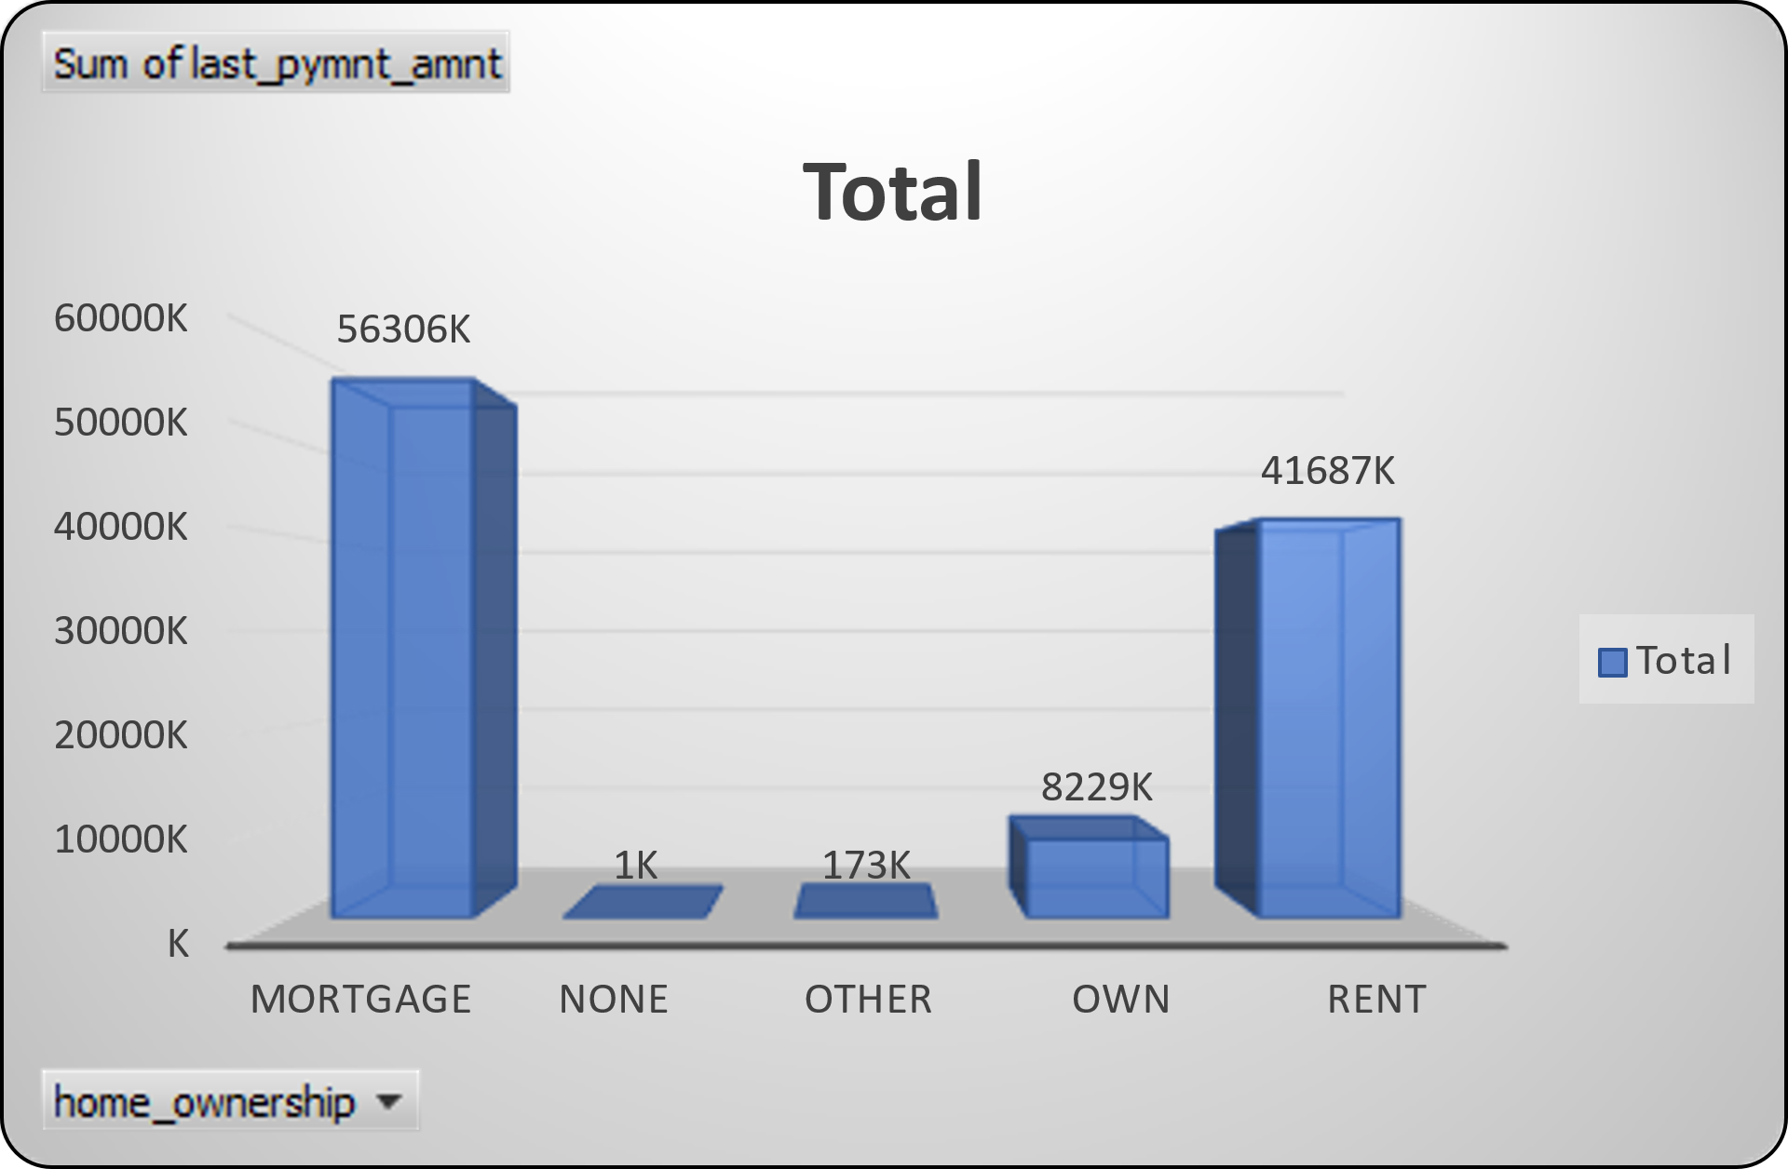
5. Home Ownership Vs Last Payment Date Stats:
This graph shows the home ownership and the amount paid for each on last payment date.
We can see that maximum amount paid by customer with MORTGAGES home ownership is 56,305,545 M
it concludes that many of the customers are about to repay their loan amount for their particular home ownership.
Home Ownership | Last payment amount
MORTGAGE | 56305545.81
NONE | 533.15
OTHER | 173239.20
OWN | 8228967.44
RENT | 41686653.09
Grand Total | 106394938.69

Slide 11
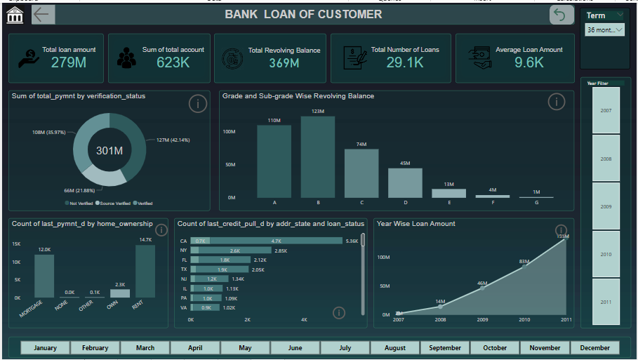
Dashboard Of Power BI

Slide 12
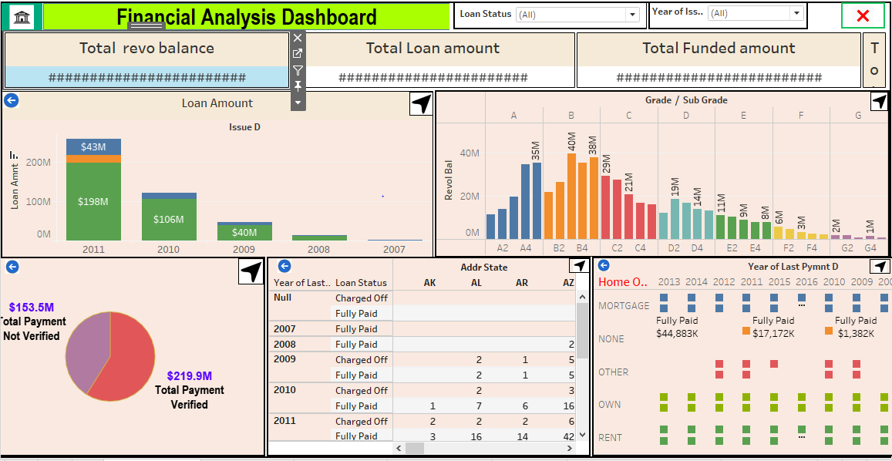
Dashboard Of Tableau

Slide 13
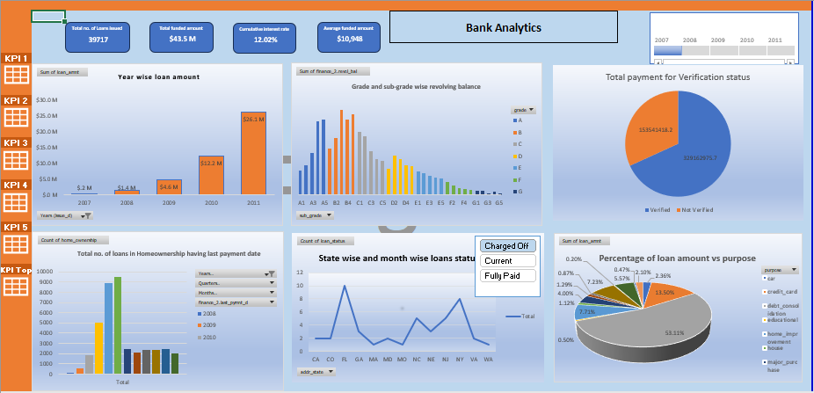
Dashboard Of Excel

Slide 14
Dashboard Of SQL

Slide 15


